Slide 1
REGULAR EXPRESSIONS

Slide 2
INTRODUCTION
A RegEx, or Regular Expression, is a sequence of characters that forms a search pattern.
RegEx can be used to check if a string contains the specified search pattern.
Python has a built-in package called re, which can be used to work with Regular Expressions.
Import the re module:
import re
When you have imported the re module, you can start using regular expressions:
Example:
Search the string to see if it starts with "The" and ends with "Spain":
→ import re txt = "The rain in Spain" x = re.search("^The.*Spain$", txt)

Slide 3
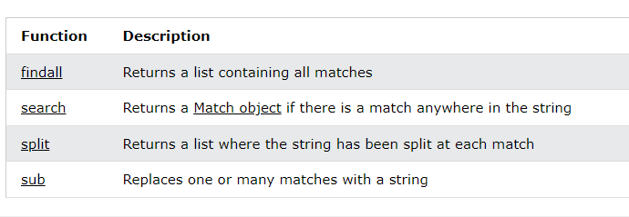
RegEx Functions:
The re module offers a set of functions that allows us to search a string for a match:

Slide 4
Matching Regex Objects.
A Regex object’s search() method searches the string it is passed for any matches to the regex. The search() method will return None if the regex pattern is not found in the string. If the pattern is found, the search() method returns a Match object, which have a group() method that will return the actual matched text from the searched string.
Example:
phoneNumRegex = re.compile(r'\d\d\d-\d\d\d-\d\d\d\d') mo = phoneNumRegex.search('My number is 415-555-4242.') print('Phone number found: ' + mo.group()) Output: Phone number found: 415-555-4242

Slide 5
Review of Regular Expression Matching:
While there are several steps to using regular expressions in Python, each step is fairly simple.
Import the regex module with import re.
Create a Regex object with the re.compile() function. (Remember to use a raw string.)
Pass the string you want to search into the Regex object’s search() method. This returns a Match object.
Call the Match object’s group() method to return a string of the actual matched text.

Slide 6
Matching Multiple Groups with the Pipe.
The | character is called a pipe. You can use it anywhere you want to match one of many expressions. For example, the regular expression r'Batman|Tina Fey' will match either 'Batman' or 'Tina Fey'.
Example:
heroRegex = re.compile (r'Batman|Tina Fey') mo1 = heroRegex.search('Batman and Tina Fey') mo1.group() Output: 'Batman' mo2 = heroRegex.search('Tina Fey and Batman') mo2.group() Output: 'Tina Fey'

Slide 7
Optional Matching with the Question Mark.
Sometimes there is a pattern that you want to match only optionally. That is, the regex should find a match regardless of whether that bit of text is there. The ? character flags the group that precedes it as an optional part of the pattern.
Example 1:
batRegex= re.compile(r'Bat(wo)?man') mo1 = batRegex.search('The Adventures of Batman') mo1.group() Output: 'Batman' mo2 = batRegex.search('The Adventures of Batwoman') mo2.group()
Output: ‘Batwoman’

Slide 8
The (wo)? part of the regular expression means that the pattern wo is an optional group. The regex will match text that has zero instances or one instance of wo in it. This is why the regex matches both 'Batwoman' and 'Batman'.
Example 2:
phoneRegex = re.compile(r'(\d\d\d-)?\d\d\d-\d\d\d\d') mo1 = phoneRegex.search('My number is 415-555-4242') mo1.group() Output : '415-555-4242' mo2 = phoneRegex.search('My number is 555-4242') mo2.group() Output :'555-4242'

Slide 9
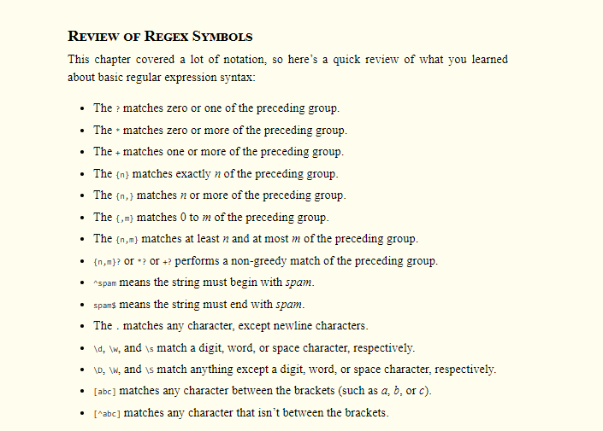

Slide 10
Regular Expression Problems In below link:

